Slide 1
Perspectives on Augmented Cognition Implementation in Military Ground Vehicle Crew Stations
Kayla L. Riegner, Ph.D.
Christopher Mikulski
DISTRIBUTION STATEMENT A.
Approved for public release; distribution is unlimited. OPSEC # 10924
Notes:
Good afternoon. Today, we will discuss how a closed-loop Augmented Cognition framework—utilizing non-intrusive physiological and behavioral sensors—can dynamically adapt crew station interfaces in military ground vehicles to manage the complex cognitive demands of supervising highly automated systems.

Slide 2
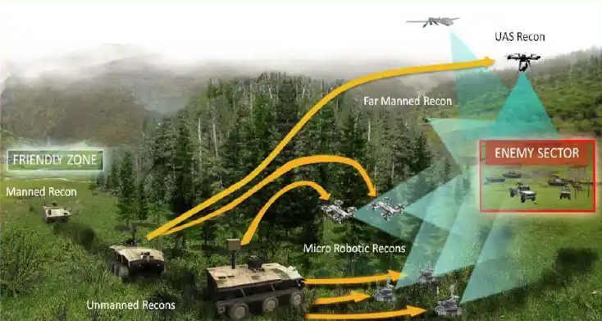
Introduction & Motivation
Military ground vehicles are transitioning from manual to highly automated systems.
This shifts the operator’s role from direct controller to supervisory monitor.
Problem: Automation doesn’t just reduce workload; it redistributes it, creating new challenges:
1. Increased cognitive load from supervisory
monitoring
2. Difficulty maintaining situational
awareness (the “out-of-loop” problem)
3. Risk of degraded vigilance and slow
response to automation failures.
Notes:
First, the motivation.
As autonomy-enabled capabilities in navigation, threat detection, and mission planning mature, they show significant potential for enhancing lethality and survivability. However, this evolution has fundamentally altered the operator's role, shifting them from a direct manual controller to more of a supervisory monitor.
A common misconception is that automation simply reduces cognitive workload. In practice, automation changes the nature of tasks performed and often redistributes workload, introducing distinct cognitive challenges. As illustrated in the operational vignette on the right, the modern battlefield is increasingly becoming an environment where operators must supervise a complex, heterogeneous network of assets—including unmanned ground and aerial systems. Managing these distributed elements in operational conditions creates a highly demanding multi-tasking environment.
This transition often results in three primary issues:
First, as autonomous agents and intelligent sensors outnumber crew members, the objective to scale the agent-to-soldier ratio requires continuous multi-source data processing, which generally leads to the elevation of cognitive load.
Second, operators often experience the 'out-of-the-loop' problem. Because they are removed from active control, their situational awareness degrades, compromising their ability to perceive environmental elements, comprehend their significance, and project future states.
Third, this passive monitoring structure degrades vigilance over extended durations, resulting in delayed response times and higher error susceptibility when automated systems fail.

Slide 3
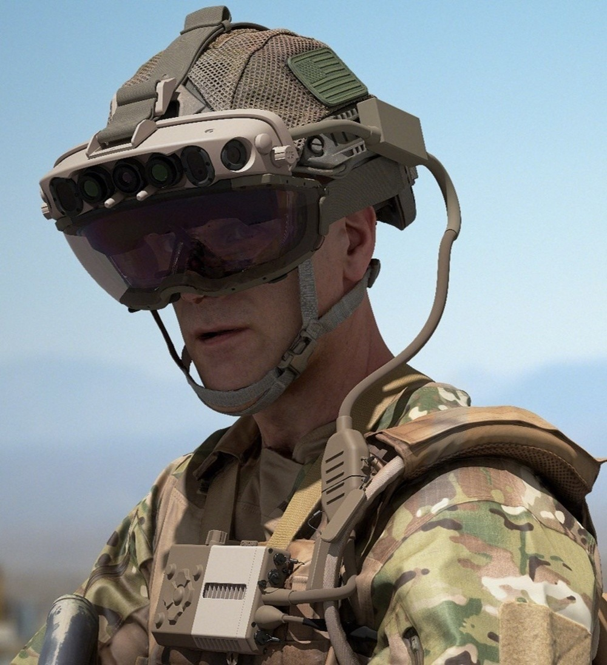
Augmented Cognition (AugCog)
What is AugCog? A closed-loop framework that uses real-time physiological and behavioral data to assess an operator’s cognitive state.
How it works: The systems dynamically adapts its user interface and level of automation in response to the operator’s state.
Goal: To optimize human-machine interaction, prevent cognitive overload, and improve overall performance and mission readiness.
Notes:
To mitigate the cognitive bottlenecks inherent in supervising multiple autonomous assets, we propose leveraging an Augmented Cognition—or AugCog—framework within future crew stations.
Originally conceptualized under early DARPA initiatives, AugCog is a closed-loop human-system architecture designed to monitor the operator's real-time cognitive state. By integrating passive, non-intrusive physiological and behavioral sensors, the system continuously estimates key cognitive metrics, including workload, attentional tunneling, and fatigue, to drive adaptations that minimize cognitive bottlenecks. For example, if the operator's visual-spatial processing channels are saturated, the system can defer non-critical visual alerts or transition them to an auditory channel. Again, the goal is to optimize human-machine interaction to prevent cognitive overload and maintain robust situational awareness.

Slide 4
Theoretical Foundations
This approach is grounded in three well-established theories and models.
Framework | Concept | Application to AugCog
Wickens’ Multiple Resource Theory (MRT) | Explains how different tasks compete for limited mental processing resources. | Explains cognitive overload in multi-tasking environments.
Endsley’s Situation Awareness (SA) Model | Defines Situation Awareness as perception, comprehension, and projection. | Highlights the “out-of-the-loop” risk during automation.
Blascovich’s Biopsychosocial Model | Differentiates between “challenge” (peak performance) and “threat” (overload) states. | Distinct physiological signatures map to different operator stress levels.
Notes:
This approach is grounded in three well-established theories and models.
First, Wickens' Multiple Resource Theory states that human information processing draws on semi-independent mental resource pools differentiated by processing stage, sensory modality, and coding channel. When concurrent task demands compete for the same resource pool, performance degrades. MRT provides us with a framework for guiding how adaptive interfaces could redirect information to underutilized sensory channels.
Second, Endsley’s three-level Situation Awareness model—which defines SA through perception, comprehension, and projection—addresses the critical 'out-of-the-loop' problem. In highly automated systems, operators transition into a passive monitoring state. This inherently degrades vigilance and increases the time required to intervene during automation failures. We propose that part of this can be mitigated by utilizing eye-tracking and physiological sensors to detect indicators of declining SA—such as gaze dispersion or altered blink rates—before situational awareness is catastrophically degraded.
Finally, Blascovich's Biopsychosocial Model of Challenge and Threat extends these paradigms. In high-demand operational environments, the human cognitive system rapidly performs a dual-appraisal process. Operators evaluate task difficulty and risk—the demand appraisal—while simultaneously assessing their capability to cope—the resource appraisal. The ratio between these two appraisals dictates the operator's physiological state. A 'challenge' state occurs when perceived resources meet or exceed demands, whereas a 'threat' state occurs when demands outstrip resources. Empirical research across high-stakes domains shows that individuals exhibiting a physiological challenge profile consistently maintain superior attentional control and execute fewer errors under pressure. Because these states yield distinct cardiovascular signatures, an AugCog framework can monitor whether the operator’s stress is likely to facilitate peak performance or actively degrade functioning, enabling precise, closed-loop interface adaptation.
I will now turn it over to Chris, who will go over some promising non-intrusive, sensing modalities, as well as future work and research.

Slide 5
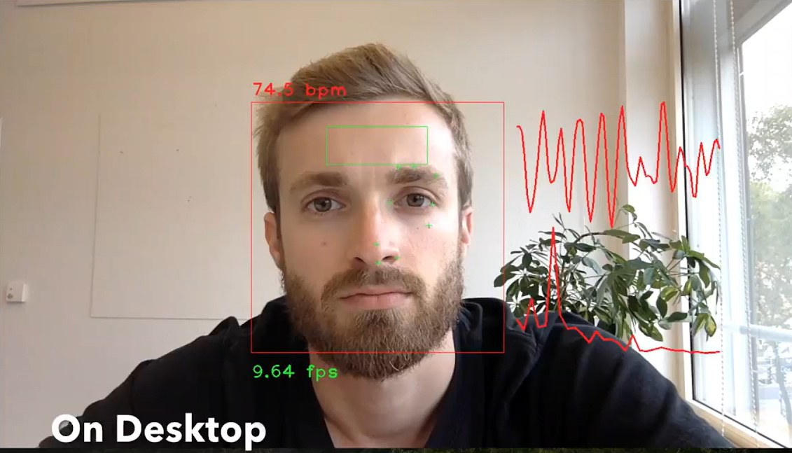

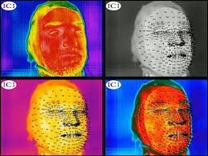
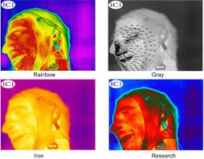

Nonintrusive Sensing Modalities
Technique | What It Measures | Description
Remote Photoplethysmography (rPPG) | Heart Rate & Heart Rate Variability (HRV) | Detects micro-changes in blood volume from video of the face by detecting subtle color variations.
Facial Thermography | Task demand, stress, and workload | Tracks facial temperature shifts (e.g., nose tip cooling due to redirected blood flow) via infrared cameras.
Eye Tracking & Pupillometry | Attention allocation, visual scanning, and cognitive effort. | Monitors gaze patterns and task-evoked pupillary responses using integrated eye trackers.
rPPG: Contactless heart rate measurement
Bonyad, A. , Abdessalem, H. and Frasson, C. (2024) The Relation between Mental Workload and Face Temperature in Flight Simulation. Journal of Behavioral and Brain Science, 14, 64-92. doi: 10.4236/jbbs.2024.142006.
Python OpenCV eye tracking
Notes:
Thank you, Kayla. Over the next two slides, I will outline six passive, nonintrusive sensing modalities that, we believe, show promise for implementation in future crew station designs. The first three are shown here.
The first one - Remote Photoplethysmography, or rPPG -estimates blood volume pulse signals directly from video of the face. It does this by detecting subtle skin color variations associated with the light-absorption properties of fluctuating subsurface blood flow. Unlike contact-based pulse oximetry, rPPG require only standard RGB or near-infrared cameras.
Notably, vehicle vibrations and face-obscuring protective gear pose some engineering challenges when deployed within a military ground vehicle context. To mitigate these, particularly in low-light or closed-hatch environments, we recommend utilizing near-infrared cameras. Also, using acceleration data to calculate, isolate, and subtract motion noise from the raw optical rPPG signal has successfully been used in higher-vibration scenarios.
Second, facial thermography uses compact, uncooled thermal imagers to produce a spatial temperature map. Under high stress or cognitive workload, the sympathetic nervous system triggers peripheral vasoconstriction, which diverts blood flow from the face. This results in a measurable temperature drop in the nasal and nose-tip regions. One thing to consider, however, is that noise from outside factors, such as ambient and crew body temperature, can create a complex background against which facial temperature variations must be discriminated. As such, when implementing this inside a vehicle crew station, regular calibration and background subtraction algorithms are needed for reliable measurement.
Finally, our third modality is eye tracking and pupillometry. Fixation locations, blink rates, and visual scan patterns serve as well-established, passive indicators of attention allocation and cognitive engagement. Modern eye-tracking hardware can now be integrated unobtrusively directly into the primary crew station display bezel.
Pupil diameter changes also add a complementary dimension. It is established that the task-evoked pupillary response is a robust index of mental effort, with pupil dilation scaling monotonically with task difficulty across a wide range of operational contexts.
Within the context of a military ground vehicle, real-time gaze and pupil metrics could serve as direct inputs to cognitive state estimators, which could then detect critical safety boundaries—such as attentional narrowing, degraded situational awareness, or impending cognitive overload.

Slide 6
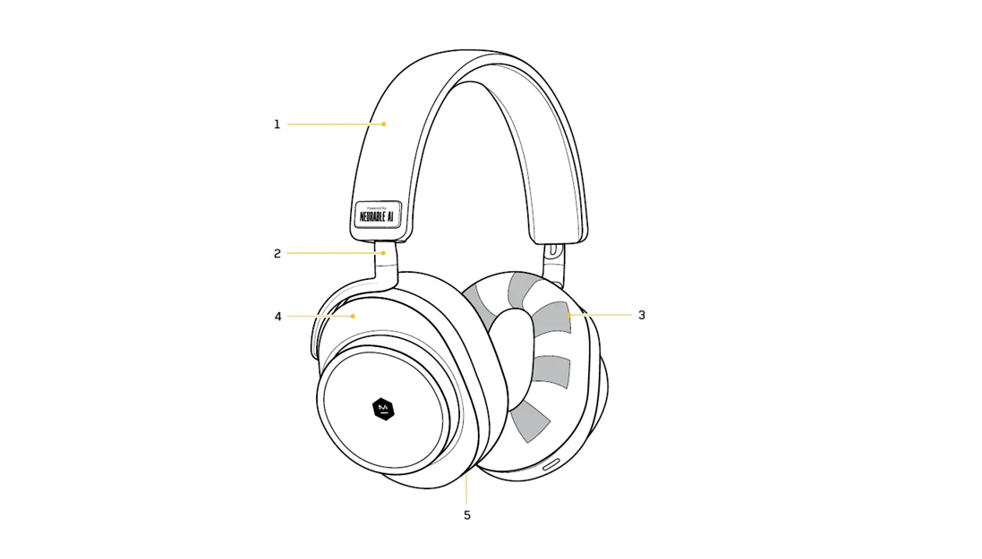

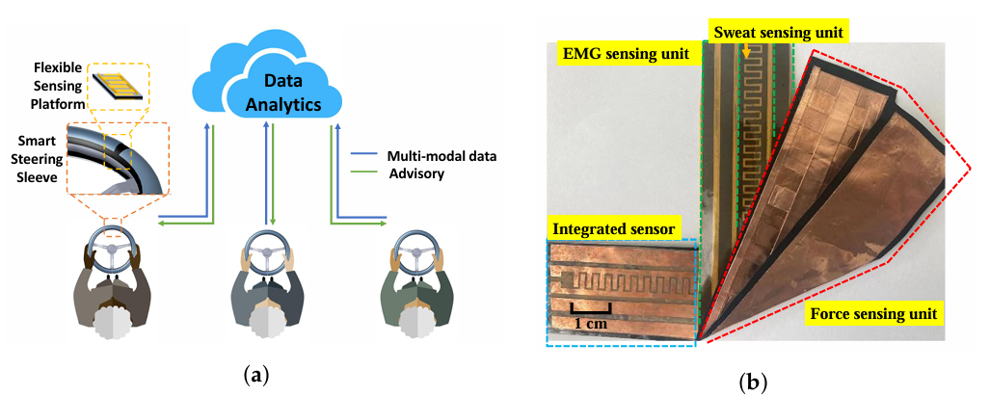
Nonintrusive Sensing Modalities
Technique | What It Measures | Description
Dry-Electrode EEG | Neural activity, cognitive workload | Captures alpha and theta brainwave bands via wearable headset sensors.
Facial Action Coding System (FACS) | Task demand, cognitive workload, and frustration | Analyzes specific facial muscle movements (Action Units) like brow furrowing (AU4) or lid tightening (AU7) via video.
Elastic Electrodermal Activity (EDA) | Acute stress events and arousal | Measures skin conductance changes.
I tested if Nootropics really work with Neurable Focus-Tracking AI Headphones data
Head, eye-tracking, and emotion tracking in real time
Head, eye-tracking, and emotion tracking in real time
Ye, C., Li, W., Li, Z., Maguluri, G., Grimble, J., Bonatt, J., Miske, J., Iftimia, N., Lin, S., & Grimm, M. (2022). Smart Steering Sleeve (S³): A Non-Intrusive and Integrative Sensing Platform for Driver Physiological Monitoring. Sensors, 22(19), 7296. https://doi.org/10.3390/s22197296
Notes:
Moving on to our last three modalities:
EEG is often considered the gold standard because it’s a direct measure of neural activity. However, historically, EEG has been operationally prohibitive due to the need for conductive gels and extensive setup times. That, however, has changed with the introduction new headsets in the market that use dry-electrodes. You could feasibly embed these dry-electrode sensors directly into the operator’s tactical communications headset to acquire gel-free brainwave signals. Now, these type of headsets collect a limited number of channels – usually about 12 – but that’s usually enough to estimate changes in power spectral density within the alpha and theta frequency bands, which are well-established indicators of cognitive workload.
Next, something that Kayla and I have been exploring extensively in recent years is the use of facial muscle movement data as an input for cognitive state estimators. Using the Facial Action Coding System, or FACS, we classify facial muscle movements into distinct Action Units, or AUs. The intensity of these AUs can be calculated in real-time using computer vision and deep learning models. The advantage of this is that this technique doesn’t require a lot - it can be implemented using small, display-mounted cameras as sensors. You can also collect a smaller subset of AUs – such those associated with concentration and task demand – and still get good estimations.
Finally, elastic electrodermal activity, or EDA, measures changes in skin conductance to index sympathetic nervous system activity, arousal, and acute stress. Now, traditionally, EDA was measured by securing a sensor to your hand, but there are some recent demonstrations of flexible, textile-based EDA sensors – for example, sleeves configured directly onto a steering wheel, joystick or yoke controller. This configuration enables continuous, passive monitoring during standard control tasks, providing early detection of things like acute stress spikes.

Slide 7
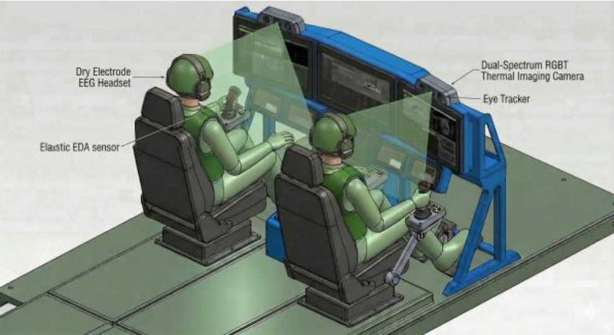
Conceptual Crew Station Design
No single sensor provides a perfect picture. Multi-modal fusion of physiological and behavioral data adds context for UI adaptation.
Sensor Placement | Sensors
Display Panel | Near infrared cameras (rPPG, FACS), Thermal Cameras (Thermography), Eye Tracker
Communications Headset | Embedded Dry-Electrode EEG sensors
Joystick / Yoke / Glove | Elastic EDA sensors integrated into controller or glove.
Notes:
This slide puts everything together from the last two slides into one conceptual crew station. The key point is that no single sensor provides a perfect picture. All are prone to various degrees of noise and artifacts, so fusing these modalities with behavioral data is a good way to provide context for user interface adaption.

Slide 8
Future Work and Research
Validation Studies
Transitioning testing from laboratory environments to operationally relevant scenarios (e.g., convoy operations, target engagement).
Sensor Fusion Algorithms
Develop robust algorithms to process multimodal data into reliable, real-time cognitive state estimations.
Adaptive System Integration
Connect outputs with vehicle C2 & autonomy stacks to enable dynamic workload sharing and intelligent alerting.
Field Prototypes
Accelerate by engineering ruggedized prototypes for hands-on Soldier evaluation.
Notes:
As for future work:
Most of what we presented today is new and emerging, so there’s not a lot of field data yet to validate system performance in naturalistic settings. As such, there’s a great need for validation studies that assess sensor and algorithmic resilience under the environmental complexities, physical vibrations, and stress profiles of actual field missions.
Second, most cognitive estimators leverage one or two modalities, but more work is needed in figuring out how best to fuse multimodal biometric data, in a way that isolates distinct sources of environmental noise and resolves conflicting sensor inputs in real time
Third, further work is required to integrate these cognitive state estimators with closed-loop adaptive autonomy systems. There are some broader adaption strategies that have been proposed, such as changing information density within the user interface or cueing the operator to different areas of the screen – but more work is needed to figure out the best way to adaptive the system based on these cognitive state inputs.
Finally, there’s a need to design ruggedized prototypes with more of these non-intrusive sensing modalities incorporated – such as a ruggedized tactical communications headset with dry-electrode EEG or a ruggedized controller sleeve with EDA measurement. The sooner we can get field-grade sensors and equipment with Soldiers, the faster we’ll be able to refine this approach.

Slide 9
Conclusion
Automation changes the nature of tasks, affecting operator workload.
Augmented Cognitions offers an approach to manage new demands by supporting an adaptive human-machine team.
A suite of passive, nonintrusive sensors and methods are being explored to enable real-time state assessment without encumbering the Warfighter.

Slide 10

Question & Answer
Contact Information:
Kayla L. Riegner, Ph.D
kayla.l.riegner.civ@army.mil
Christopher Mikulski
christopher.m.mikulski.civ@army.mil

